Slide 1

5 EXOTIC FLOWERS
BY VYOM MAHAJAN

Slide 2
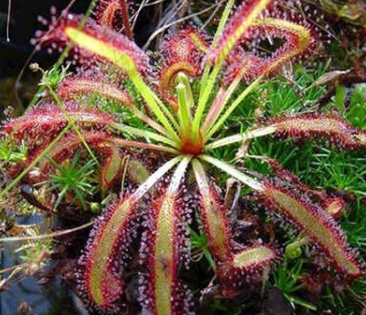
CAPE SUNDEW
Drosera Capensis, commonly known as cape sundew is a small rosette-forming carnivorous species of perennial sundew native to the cape in South Africa. Because of its size, easy to grow nature, and the copious amounts of seeds it produces, it has become one of the most common sundews in cultivation.
It produces strap-like leaves, up to 3.5 centimetres long and 0.5 centimetres wide, which, as in all sundews, are covered in brightly coloured tentacles which secrete a sticky mucilage that traps arthropods.

Slide 3
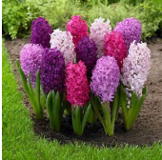
HYACINTH
Hyacinthus is a small genus of bulbous, fragrant flowering plants in the family Asparagaceae, subfamily Scilloideae. These are commonly called Hyacinths. They are native to the Mediterranean region.
They grow from bulbs, each growing four to six linear leaves and one to three spikes of flowers. In the wild species, the flowers are widely placed as few as two per raceme (it is a flower when the petals are undeterminable) in Hyacinthus Litwinovii and typically six to eight in Hyacinthus orientalis, which grows to a height of 15-20 cm.

Slide 4
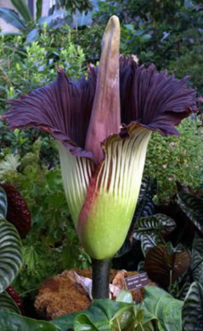
TITAN ARUM
Amorphophalus titanum, the titan arum, is a flowering plant with the largest unbranched inflorescence in the world. The titan arum’s inflorescence is not as large as the talipot palm, but the inflorescence (it is when a flower directly grows from a stem) of the talipot palm is branched rather than unbranched.
Due to its odor, which is like the smell of a rotting corpse or carcass, the titan arum is categorized as a carrion flower, or is also known as corpse flower or corpse plant.
The titan arum’s inflorescence can reach over 3 metres in height.

Slide 5
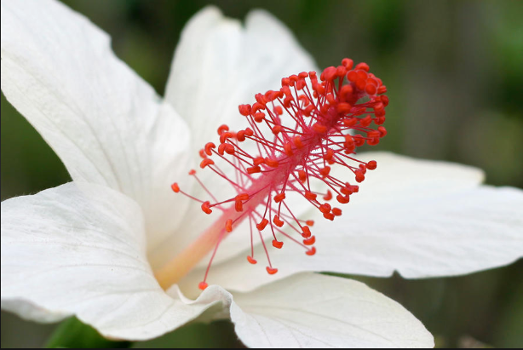
KOKI’O
Kokia cookie is a small, deciduous tree, commonly known as koki’o, Moloka’i treecotton, cooke’s koki’o, or moloka’i koki’o.
This species is only known to have existed in the lowlands of western Molaka’i island of the Hawaiian Islands. Its native habitat was lowland dry forests on the leeward western end of the island. This was all cut down by the Polynesian settlers about the year 1000 CE to make room for agriculture. It survived and can adapt quickly to its surroundings.

Slide 6
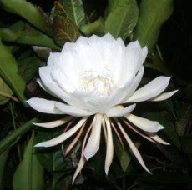
SAUSSUREA OBVALLATA
Saussurea obvallata is a species of flowering plant in the Asteraceae. It is native to the Himalayas, Himachal Pradesh and Uttarakhand, India, Mongolia, northern Burma and southwest China.
In the Himalayas it is found at an altitude of 4500 metres. It is the state flower of Uttarakhand. It is a perennial flower growing up to 0.3 centimetres. The flowers are hermaphrodite (have both male and female organs) and are pollinated by insects.
Known as brahma kamala in India.

Slide 7
THE END
REFERENCE - WIKIPEDIA

